Slide 2
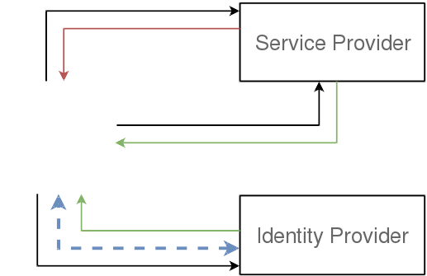

SAML WebSSO

Slide 3
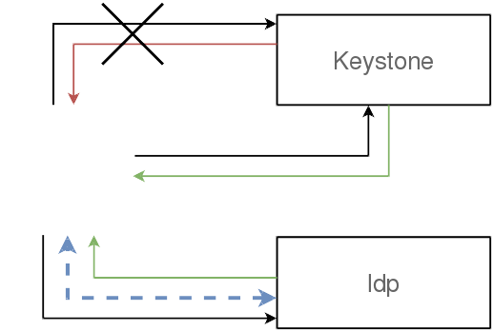
It's not that simple...

Slide 4
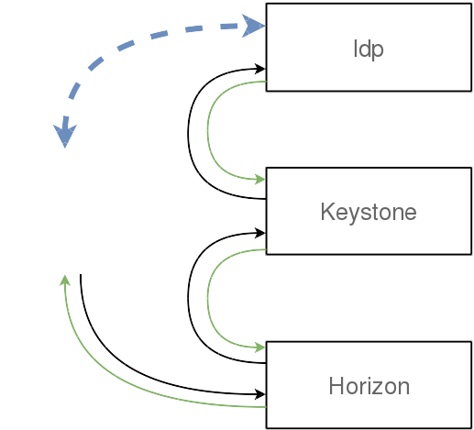
Adding Keystone

Slide 5
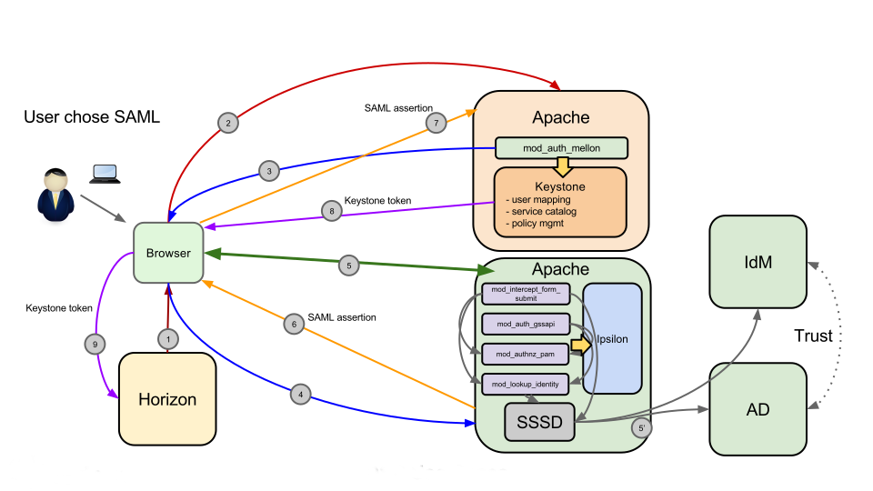
Or more accurately

Slide 6
Ipsilon
Universal Adapter of Identity Providers
  Frontend: SAML
  Backend: SSSD, PAM
  Authentication: Password, Kerberos
1.0.0 Released on 2015-05-12
https://fedorahosted.org/ipsilon/

Slide 7
DEMO
Kilo
Nova, Glance, Cinder, Keystone, nova-network
V3 Identity everywhere
github.com/jamielennox/pyconau2015-ansible/
  does rely on some non-public nightly repos
May the force be with us...

Slide 8
Steps
Create the identity provider in keystone
  Keystone uses a single websso entry point (per protocol)
Configure keystone to accept SAML websso
  Trust between keystone ↔ ipsilon
Configure horizon to use websso
  Trust between horizon ↔ keystone
Map properties from Idp into keystone

